Slide 1

Big Mountain Resort:
Ticket Price Prediction & Scenario Modeling
Executive Presentation
Prepared by : Md A Rahman Ruhel

Slide 2


Identifying the Pricing Challenge!
Big Mountain Resort currently charges $81 for an adult weekend ticket.
Management is uncertain whether this price fully reflects the resort’s facilities and value compared to other resorts.
Predict a fair market ticket price using data-driven models and evaluate how changes to amenities could affect this price.

Slide 3

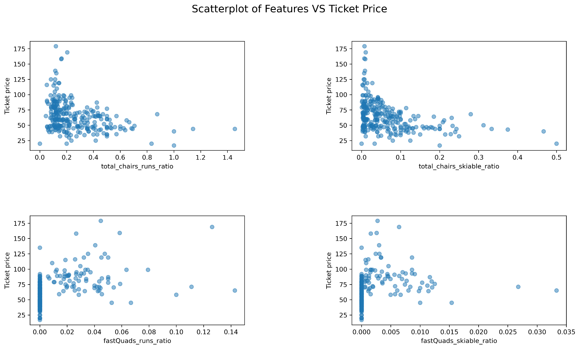
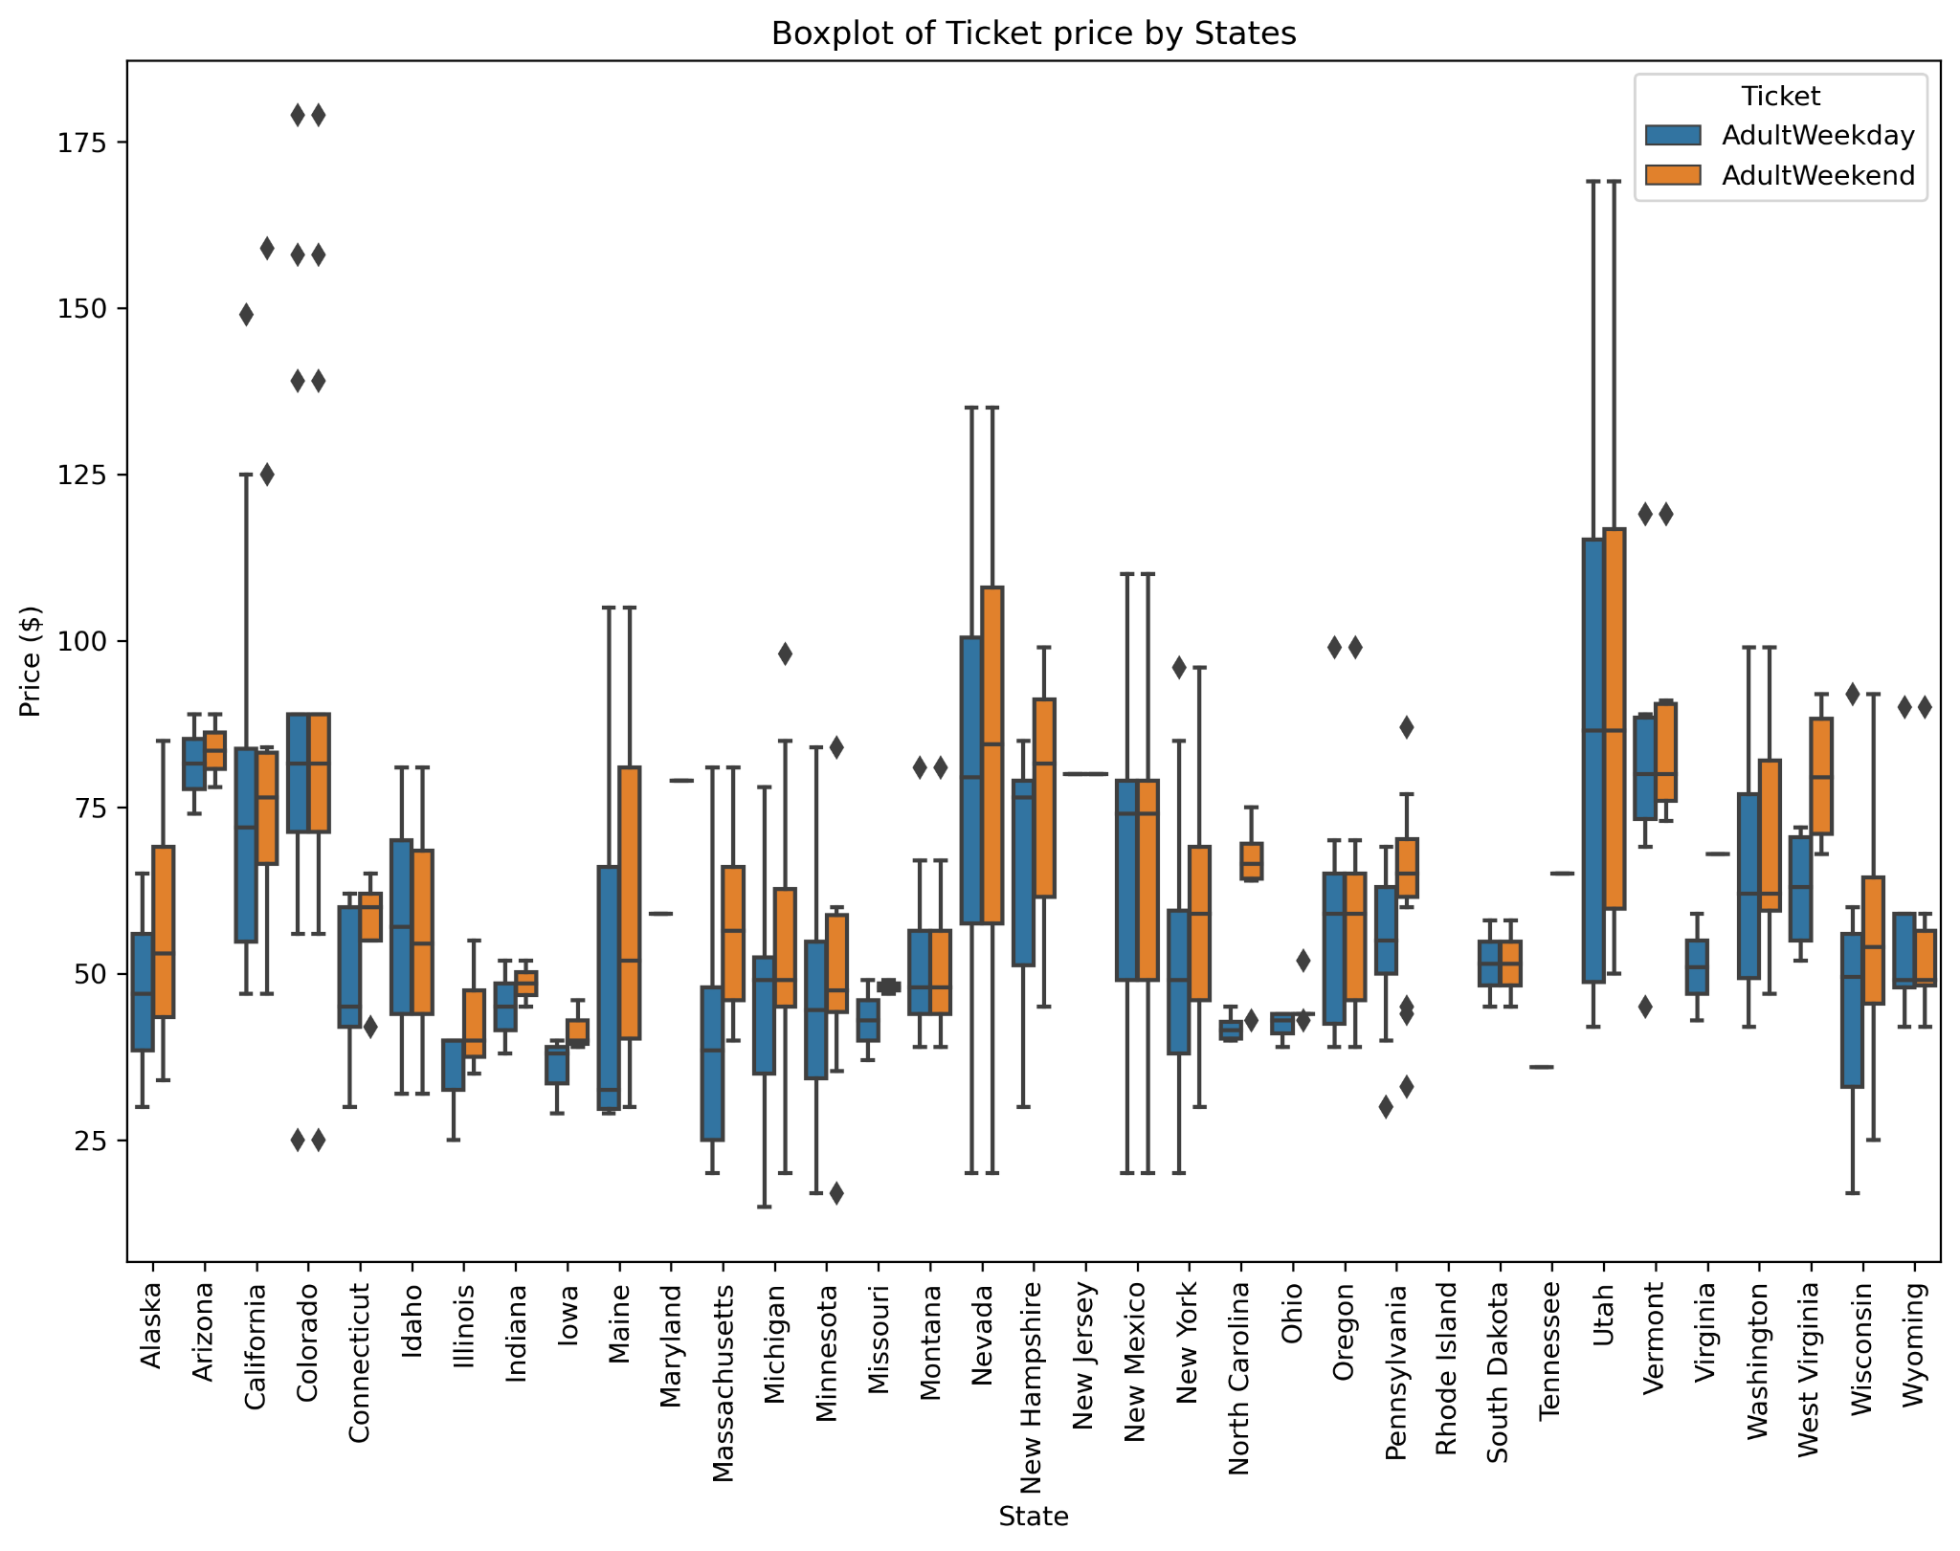
Data Sources and Key Factors:
Analyzed data from multiple comparable North American ski resorts.
Features included:
Elevation, vertical drop, runs, lifts, snowmaking area, night skiing area.
Local population data to estimate market competition and density.
Cleaned data, removed inaccurate entries, and engineered ratios for deeper insights (e.g., resorts per 100k population.

Slide 4

Recommended Strategy:
Increase adult weekend ticket price gradually to the $92–$97 range, in line with comparable resorts.
Focus on communicating the value and facilities to justify the increase.
Avoid large capital expansions expecting ticket price gains alone to cover costs; improvements like new lifts have minimal pricing impact.
Prioritize smaller, cost-effective enhancements and marketing to maintain customer satisfaction and loyalty.

Slide 5

How We Built the Pricing Model:
Baseline Model: Predicted average price → R² ≈ 0, MAE ~$19.
Linear Regression: Used all numeric features → Train R² = 0.83, Test R² = 0.71, MAE ~$9.
Feature Selection: Applied SelectKBest → Identified 8 key predictors, reduced overfitting.
Random Forest Regressor: Tuned with GridSearchCV → Captured nonlinear effects, lowest MAE, highest stability across folds.

Slide 6

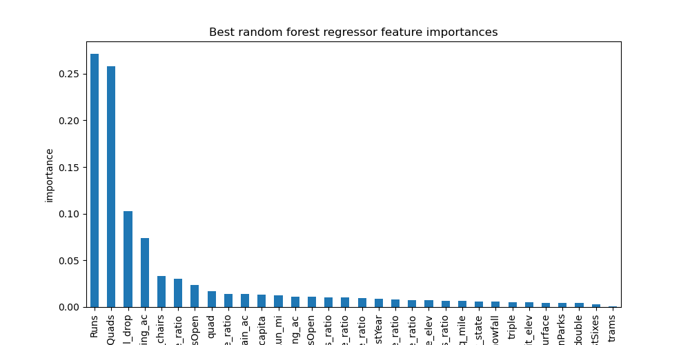
Key Drivers of Price:
The Random Forest highlighted the most impactful factors:
Vertical Drop: Higher drop increases perceived value.
Snowmaking Coverage: Better snow reliability supports higher prices.
Lift Capacity & Number of Runs: More lifts and runs improve customer experience.
Terrain and Night Skiing: Contribute modestly.

Slide 7

Scenario modeling Insights
Closing 1–3 runs: No significant price change.
Closing 4–5 runs: Ticket price drops measurably.
Adding vertical drop + new lift: Increases price by only ~$0.41 — insufficient to justify high capital cost.
More snowmaking or longer runs: Minimal pricing effect.
Scenario | Price Predicted
Current Facilities | $81
Closing 5 runs | ~$75–$78
Adding lift & vertical | +$0.41/ticket
More snowmaking | Negligible

Slide 8


Key Takeaways
Action Plan
Big Mountain Resort is currently underpricing tickets.
Data suggests a market-supported range of $92–$97 for adult weekend passes.
Major expansions unlikely to pay for themselves via ticket sales alone.
Implement gradual price increases.
Pair price changes with visible guest experience improvements.
Communicate value clearly to maintain customer trust.
Continue monitoring competitor prices and market trends.

